Slide 1
MASTERPIECES OF WESTERN ART Art Humanities W1121 Section 15
The Parthenon
(Part 1)

Slide 2
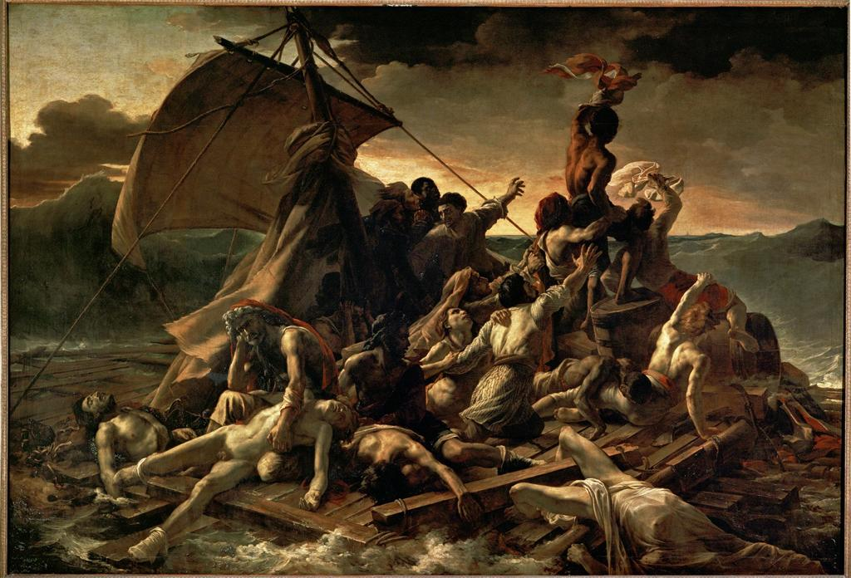
Géricault
The Raft of the Medusa
1819
16’1” x 23’6”

Slide 3
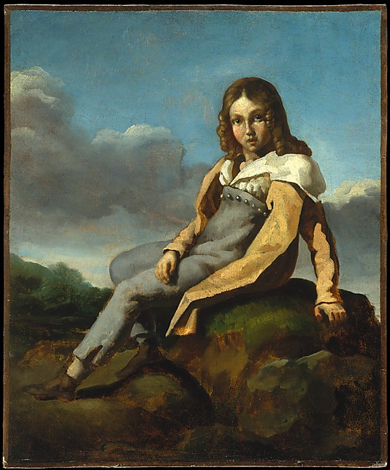
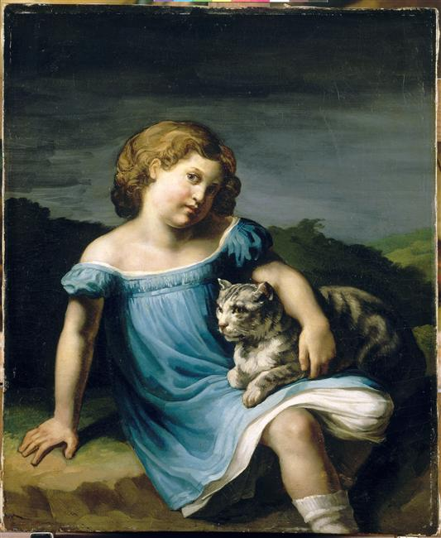
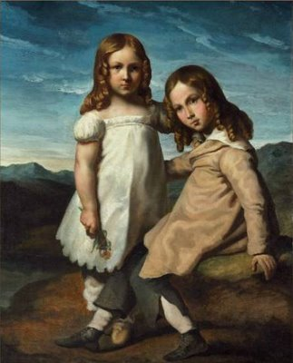

Slide 4
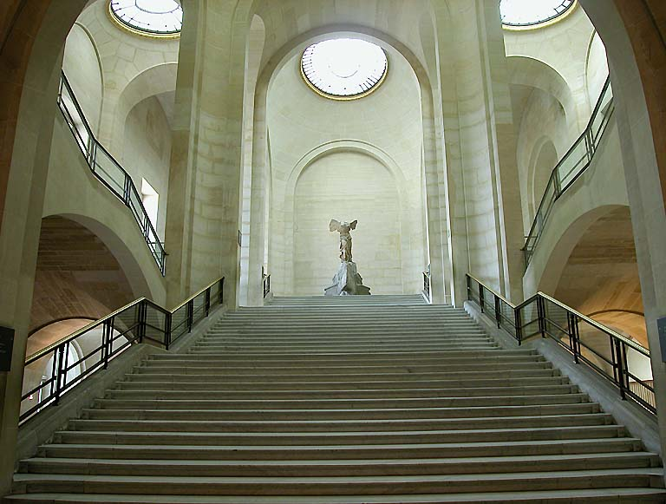
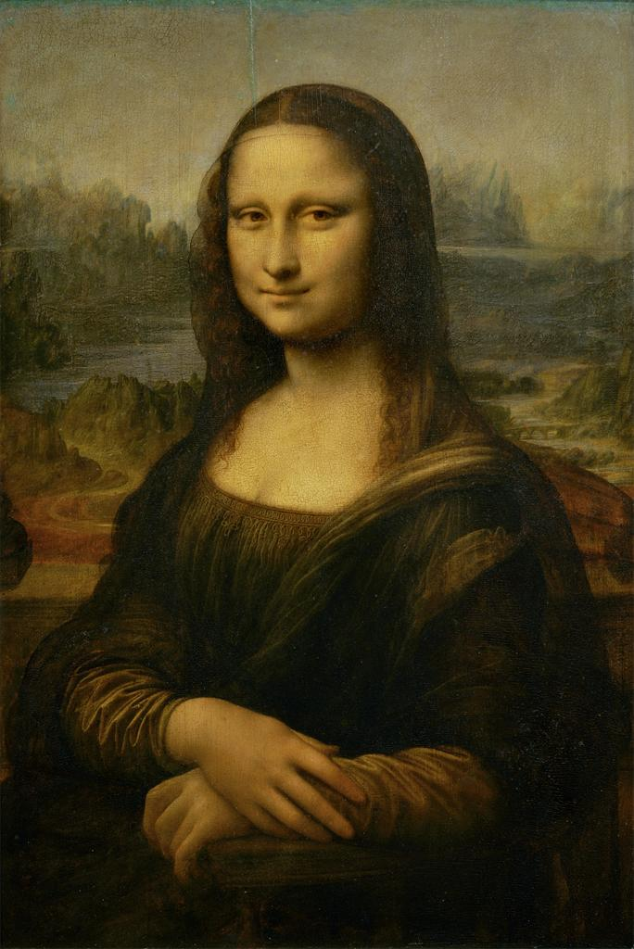
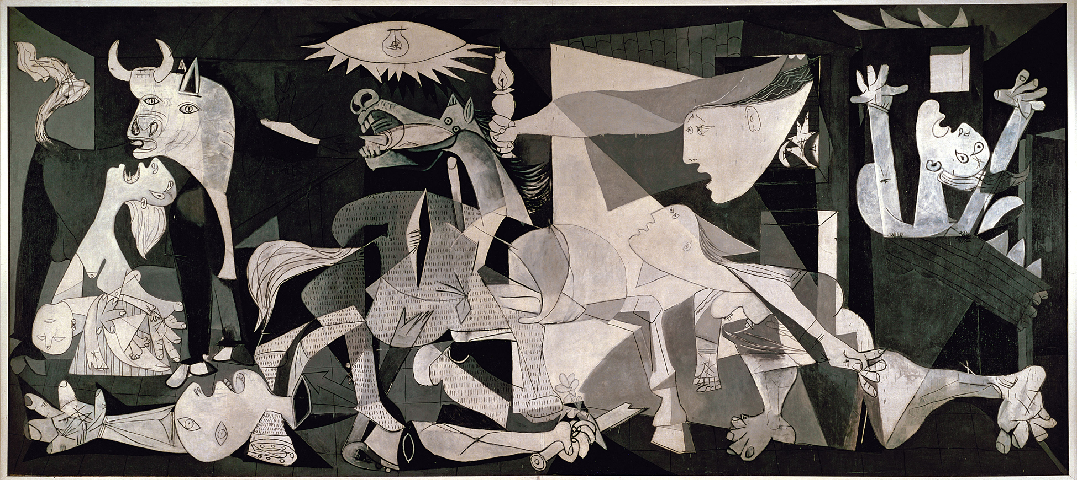

Slide 5
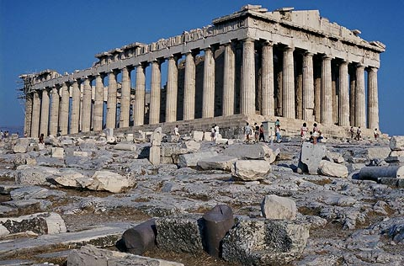
The Parthenon

Slide 6
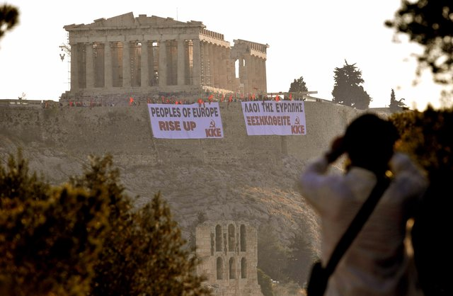

Slide 7
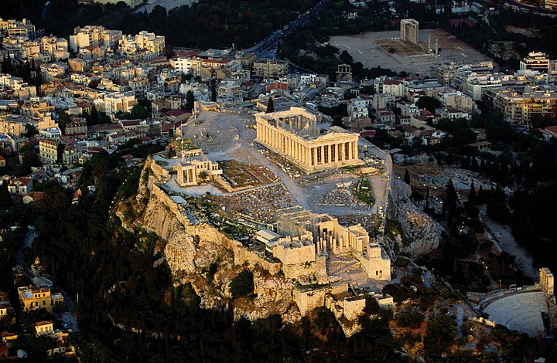
Partial aerial view of Athens with the Acropolis, heart of the Polis

Slide 9
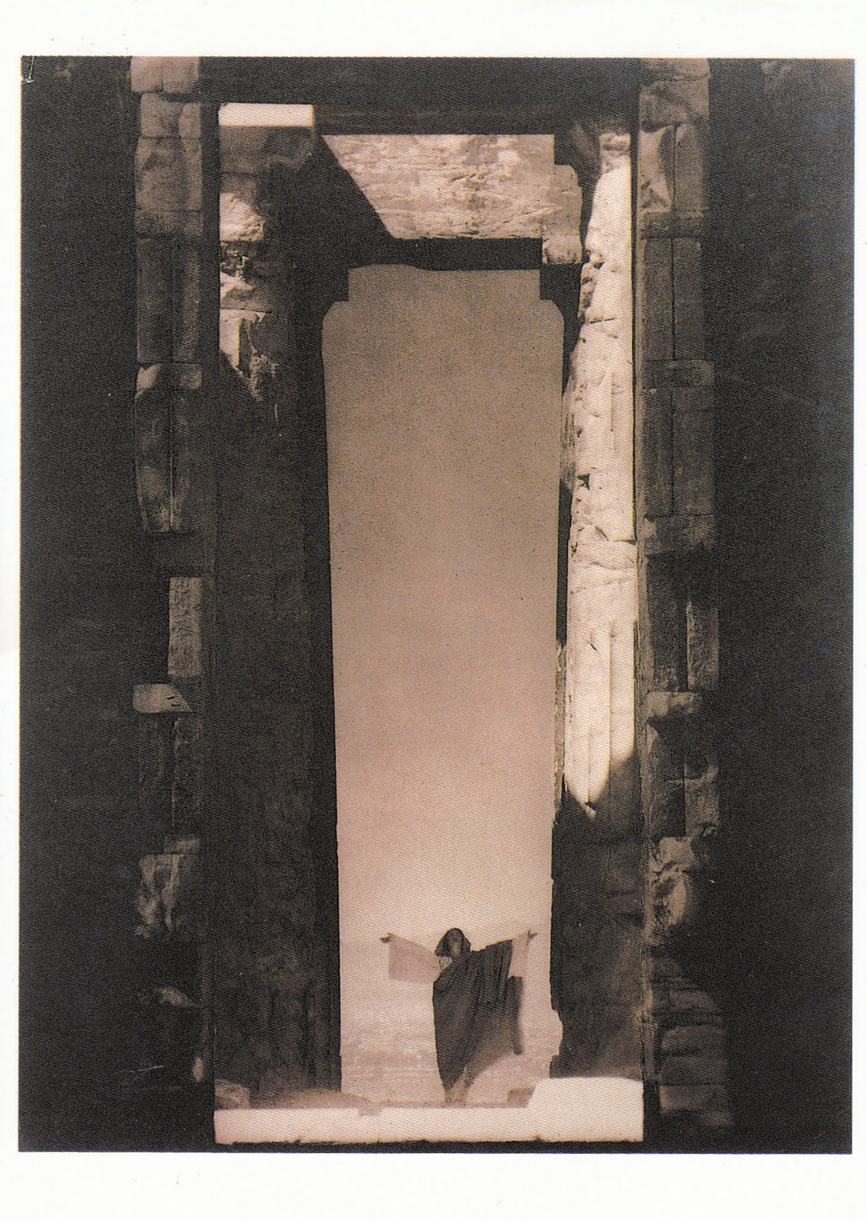
Edward Steichen
Isadora Duncan at the
Portal of the Parthenon
1920

Slide 10
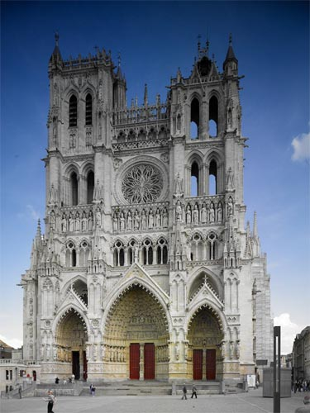
Parthenon
Amiens Cathedral

Slide 11
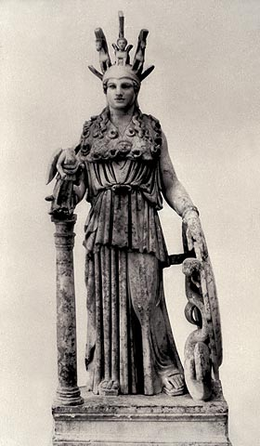
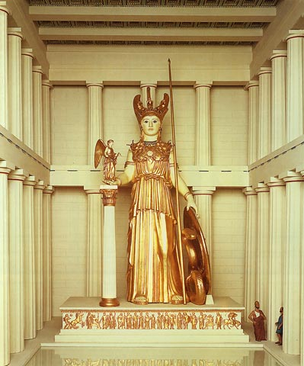
Phidias, Athena Parthenos
Roman copy
Chryselephantine model

Slide 12
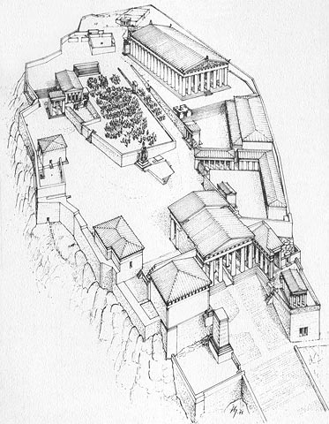
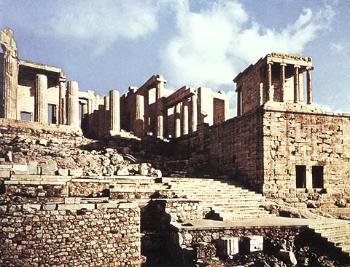
Reconstruction of the Acropolis,
site of the Panatheniac Festival
(or “Panathenaea”)
Propylaea and Temple of Athena Nike

Slide 13
Parthenon (447-432 B.C.) View from the Northwest
Architects: Iktinos and Kallikrates

Slide 14
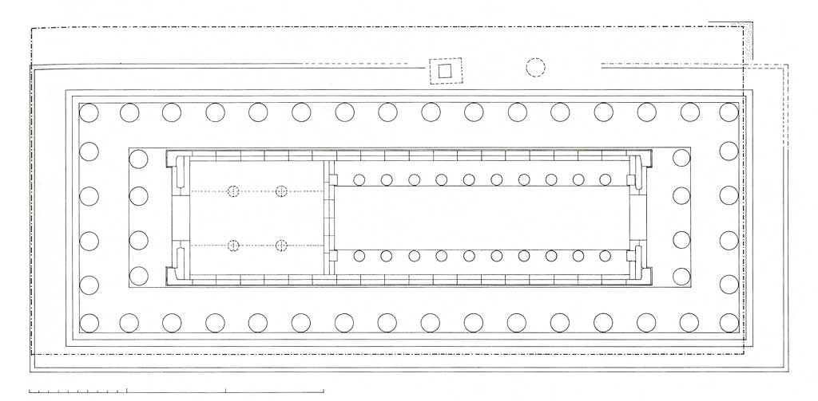
Plan of the previous temple on the site of the Parthenon (488-480 BC).
The outline of the present Parthenon is shown as the dotted line.

Slide 15
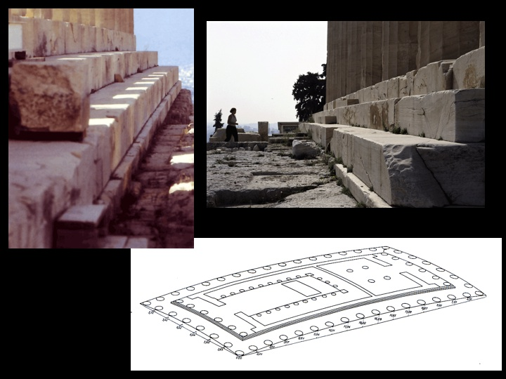
Parthenon, stylobate

Slide 16
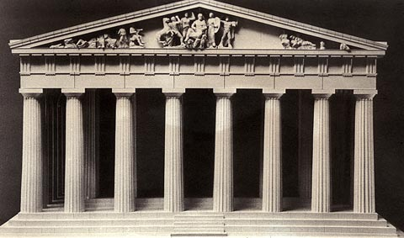
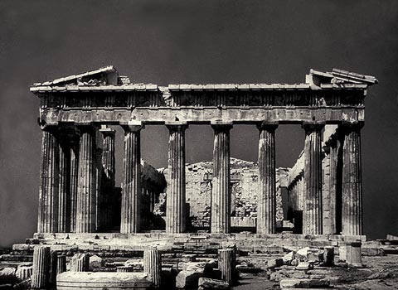
Parthenon, East façade

Slide 17
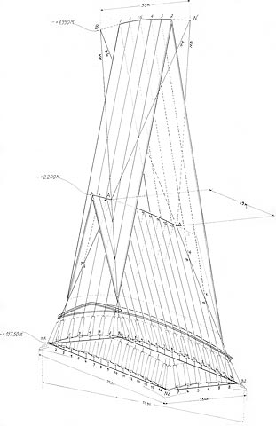
Extrapolate diagram showing the curvature of the horizontal lines and the inward inclination of the external columns of the Parthenon

Slide 18
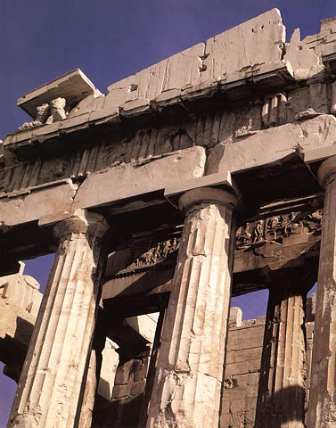
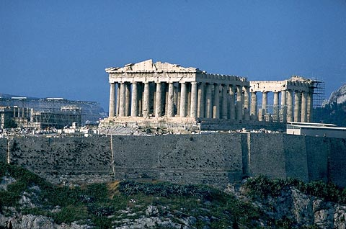
Parthenon (447-432 B.C.)
View from the Southwest
Parthenon, West façade

Slide 19
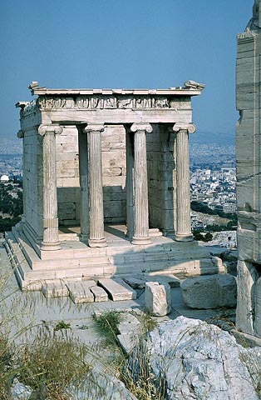
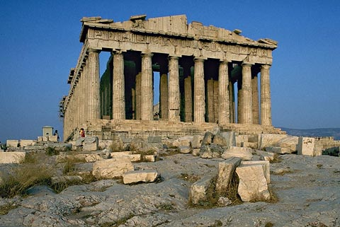
Doric Temple vs. Ionic Temple
Parthenon
Temple of Athena Nike
Athens, Acropolis
427-424 B.C.

Slide 20
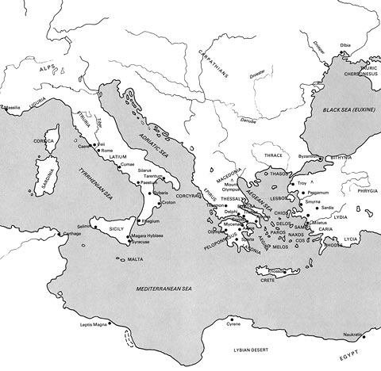
Map of the Greek
and Roman world

